Slide 1

Securing the Future:
Trust and Safety in
AI Development
Lawrence Crowther
Head of Solutions Engineering, APJ
Snyk

Slide 2
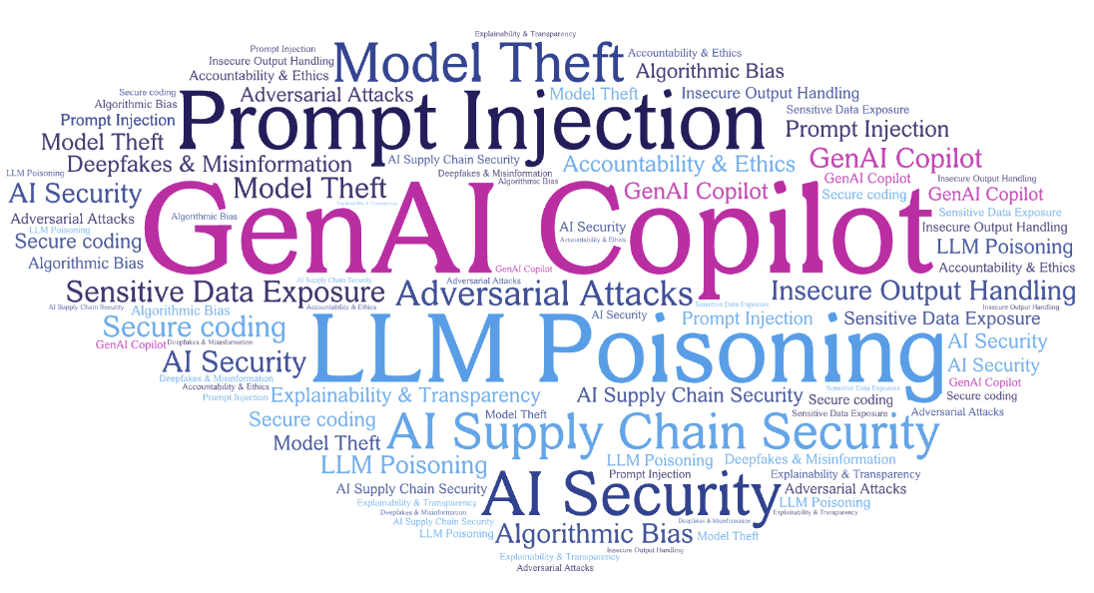
Demystifying AI Security

Slide 3
Defend With
Key considerations for CISOs
GenAI
Consume
Attacked By
Build
Source: “4 Ways Generative AI Will Impact CISOs and Their Teams” - Gartner Research

Slide 4
AI with Security Context
Prompt Injection
Training Data Poisoning
Supply Chain Vulnerabilities
Insecure Output Handling
AI-Assisted Applications
Reduce False Positives
Automated Code Fixes
Interpreting Log Data
Risk Profiling
AI Hallucinations
Generating in-secure Code
Old Outdated Packages
Sensitive Data Leakage
AI-Assisted Development
AI-Assisted Processes

Slide 5
Businesses will embrace generative AI, regardless of security.

Slide 6

But What is the Low Hanging Fruit?
GenAI Security Companion

Slide 7






GenAI = speed + volume + complexity
\
More code
More speed
More Vulns
Notes:
Key Point
Align with the customer that:
AI is something they have to lean into vs fight - competitive need for the business, developer supercharger
AI exacerbates the application security problem they already have - even more code, with even more vulnerabilities means security team is even less able to keep up - either slowing progress or releasing more vulnerable code.
More code from experienced developers getting faster
Morde code from inexperienced or ‘citizen’ developers
Data points:
Why: AWS & GitHub studies show 55%+ productivity boost with AI
So: GitHub sees 92% of US devs already using AI coding tools
But: NYU saw 40% of Co-pilot code created vulns, Stanford found devs using AI produces less secure code than devs without AI, but thought they had produced more secure code.
Transition to: Traditional appsec approaches will fail.

Slide 8




Risks of AI code generation
Quality
Blind Trust
Vulnerabilities
IP Violations
Notes:
Quality and Reliability
AI-generated code’s quality and reliability may vary due to training on incomplete or biased datasets.
AI hallucinations suggest non-existing packages that enable supply-chain attacks.
Blind Trust
Devs commit generated code (they may not entirely understand), and the reviewer isn’t thorough.
Imagine one dev generates the code, other dev uses AI to review it and then they ship that to production.
Security Vulnerabilities
AI-generated code may introduce new vulnerabilities due to flaws in AI models or biased training data.
Multiple studies already showed that although ChatGPT can generate code, but it only sees basic security flaws.
Intellectual Property
Code generation AI carries the risk of unintentional intellectual property violations.
If your company will go through acquisition having code ownership is important.

Slide 9
At least 3 breaches will be publicly
blamed on AI-generated code.
-Forrester Predictions 2024: Cybersecurity, Risk, And Privacy
Notes:
Janet: Compounding complexity on what AI brings to the table.
Jonaki: Wow! If youre bringing your own AI, you should secure it with Synk. We think it’s a great way to use GenAI securely. What other opps do you see for us

Slide 10
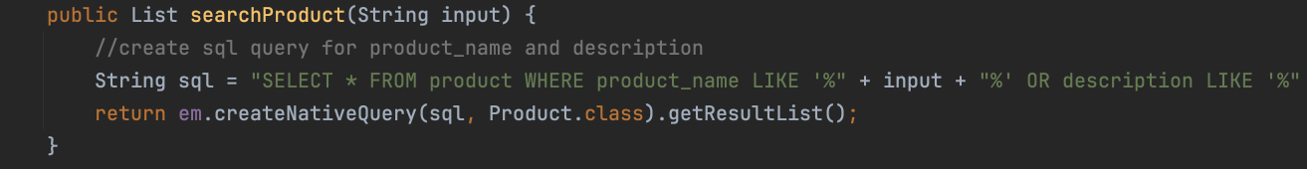
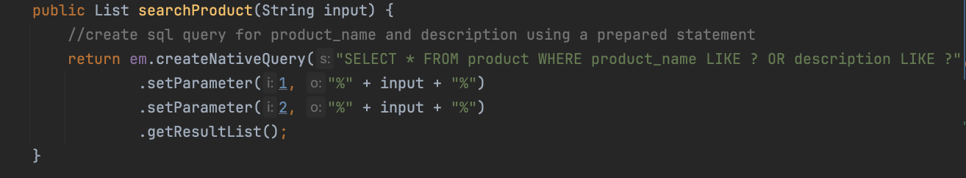
Real world example
typical prompt
SQL Injection
explicit prompt
secure

Slide 11
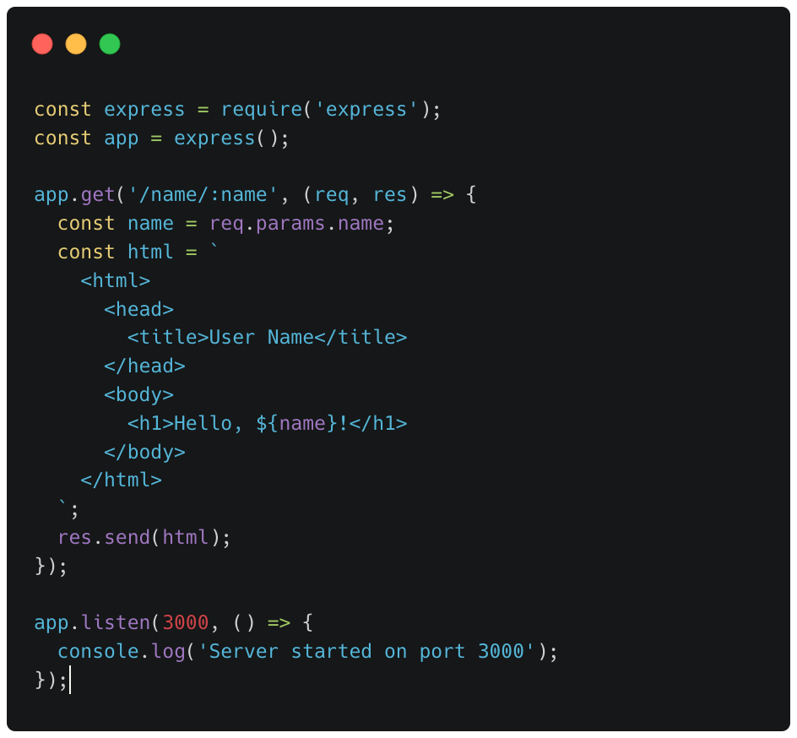
another example…
Prompt provided to Bard (Gemini), GPT-3.5 + GPT-4
name parameter output without sanitization
Results in typical reflected Cross-Site Scripting vulnerability

Slide 12
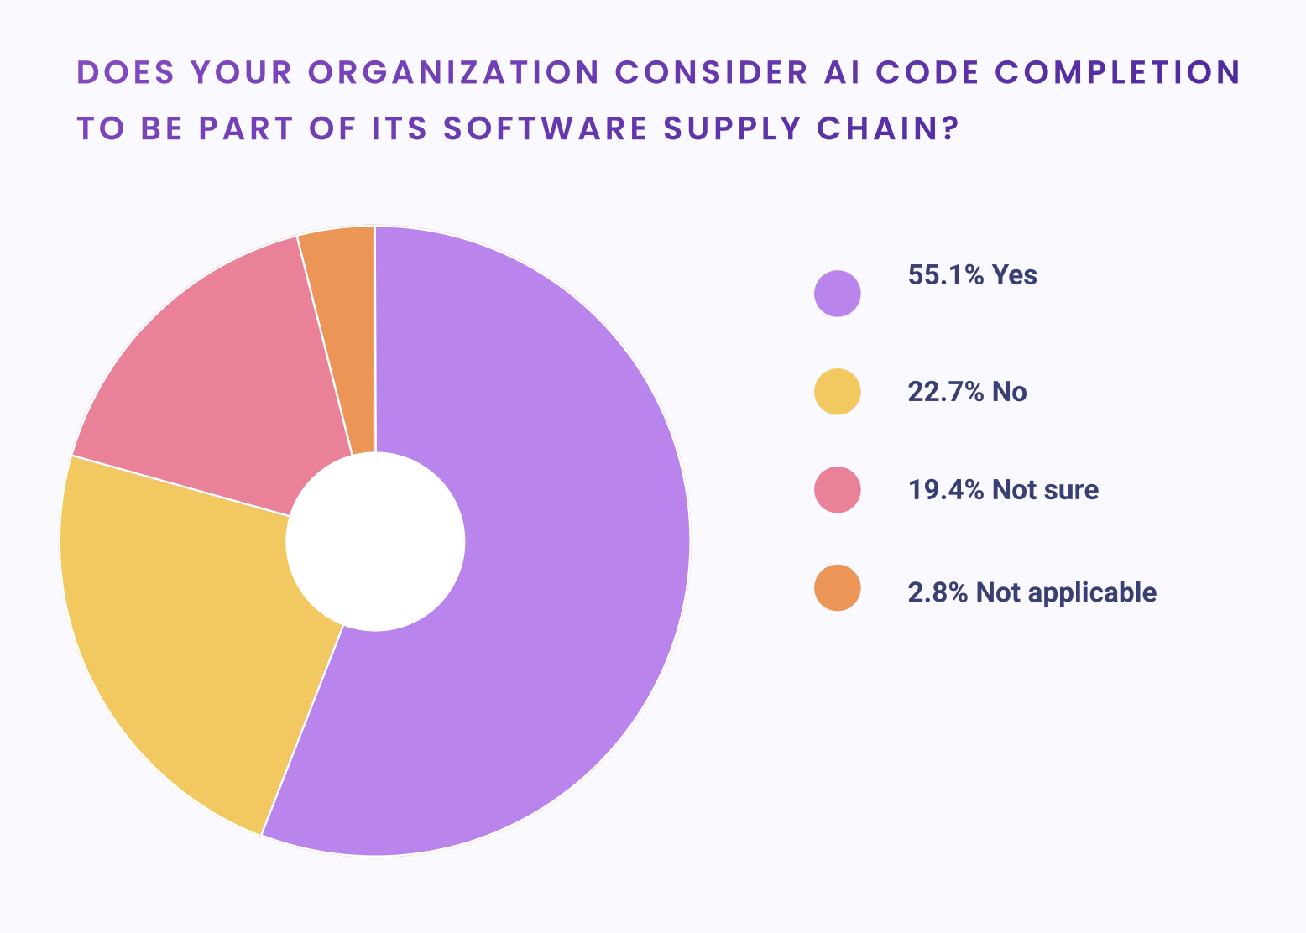
Gen AI is a part of your supply chain
source: http://snyk.io/reports/ai-code-security/

Slide 13
The supply chain grows
🧑🏽‍💻
🧑🏽‍💻
?
?
Libraries
Containers
🧑🏽‍💻
Code (Git)
Build (CI)
Storage
Consumer
🧑🏽‍💻
🧑🏽‍💻
IDE’s
CI Plugins
Build Tools
Build Envs
?
?
🧑🏽‍💻
🧑🏽‍💻

Slide 14
The supply chain grows
🧑🏽‍💻
🧑🏽‍💻
🧑🏽‍💻
?
?
?
AI Model
Libraries
Containers
🧑🏽‍💻
Code (Git)
Build (CI)
Storage
Consumer
🧑🏽‍💻
🧑🏽‍💻
IDE’s
CI Plugins
Build Tools
Build Envs
?
?
🧑🏽‍💻
🧑🏽‍💻

Slide 15
The supply chain grows
🧑🏽‍💻
🧑🏽‍💻
🧑🏽‍💻
?
?
?
AI Model
Libraries
Containers
🧑🏽‍💻
Code (Git)
Build (CI)
Storage
Consumer
🧑🏽‍💻
🧑🏽‍💻
IDE’s
CI Plugins
Build Tools
Build Envs
?
?
🧑🏽‍💻
🧑🏽‍💻

Slide 16
The supply chain grows
🧑🏽‍💻
🧑🏽‍💻
🧑🏽‍💻
?
?
?
AI Model
Libraries
Containers
🧑🏽‍💻
Code (Git)
Build (CI)
Storage
Consumer
🧑🏽‍💻
🧑🏽‍💻
IDE’s
CI Plugins
Build Tools
Build Envs
?
?
🧑🏽‍💻
🧑🏽‍💻

Slide 17


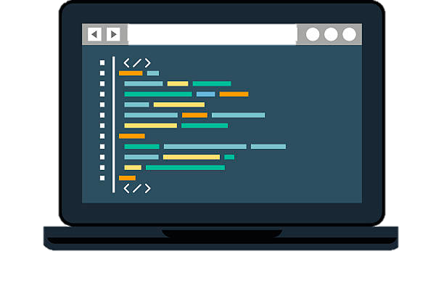

Takeaways
Education and awareness
Write up policies and company guidelines
Focus on security vulns, sensitive data and IP and human interaction
Make education actionable making sure repeatable steps can be taken
Don’t trust. Verify.
Treat AI code like it’s from an inexperienced dev/app sec engineer
Test/validate everything
Pair ChatGPT, Co-Pilot with AST in the IDE

Slide 18
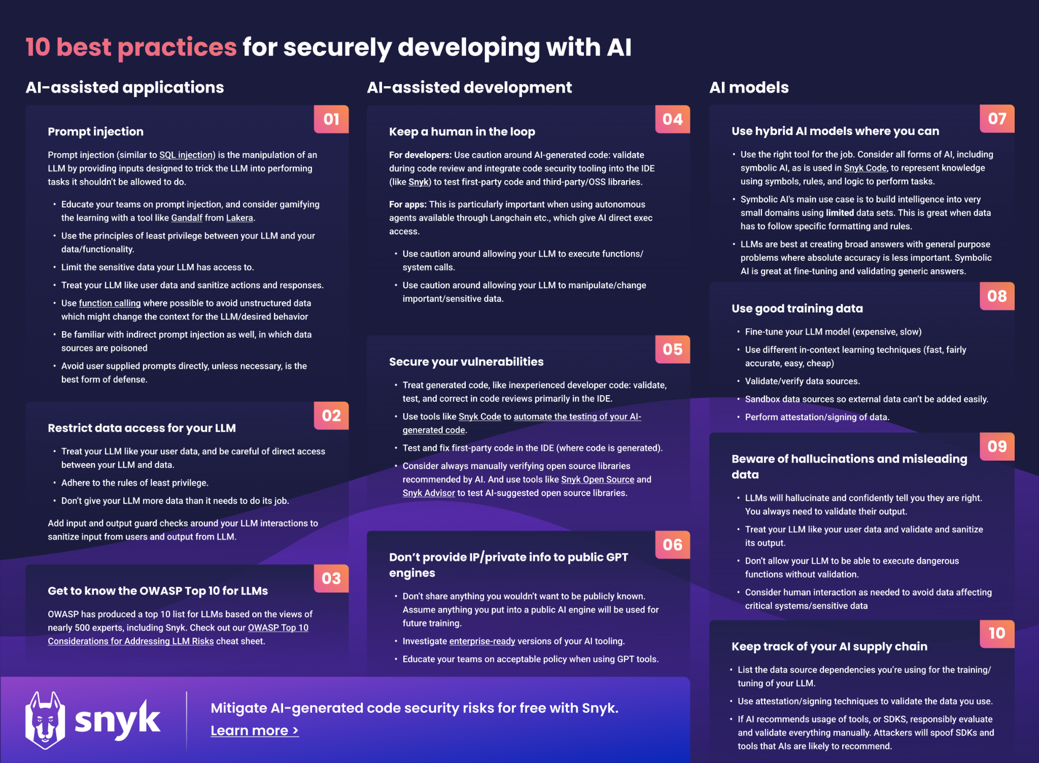
Further reading
source: https://snyk.io/blog/10-best-practices-for-securely-developing-with-ai/

Slide 19
Thank you!

